Slide 1
Satyr Σάτυροι
Greek mythology

Slide 2
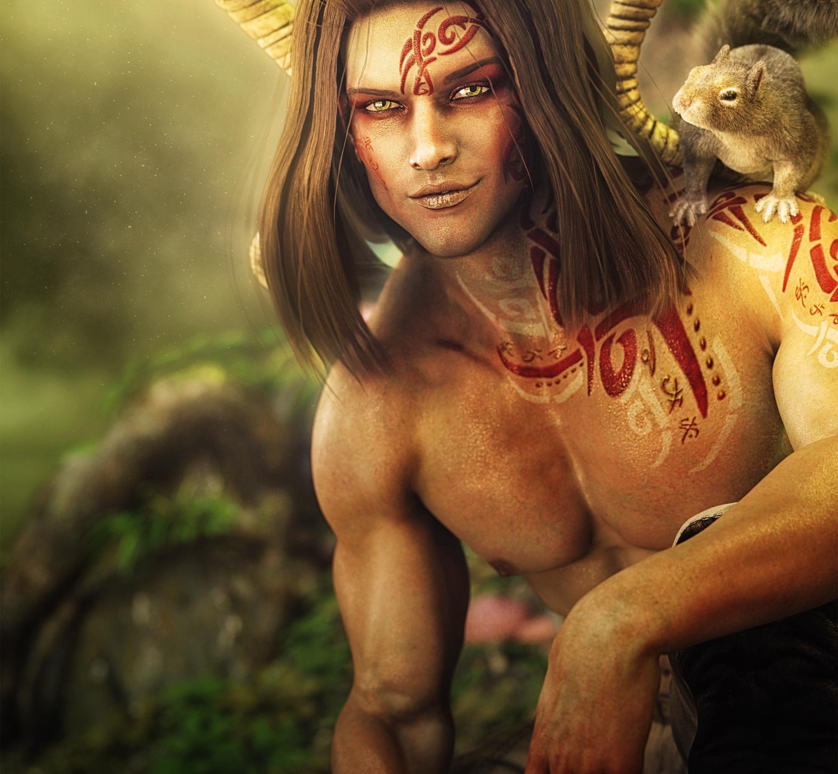
SATYR
is a male nature spirit with ears and a tail resembling those of a horse, as well as a permanent, exaggerated erection. Early artistic representations sometimes include horse-like legs, but, by the sixth century BC, they were more often represented with human legs

Slide 3
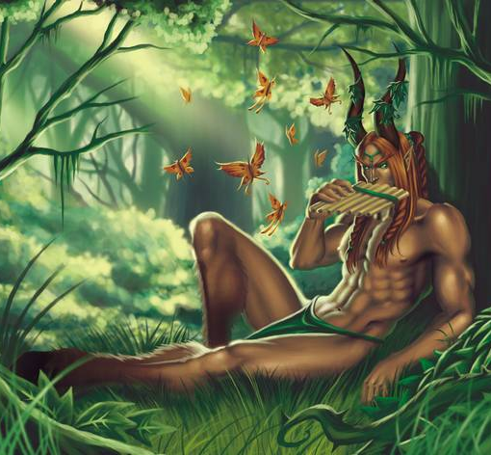
where from can be found?
In the modernity of satyrs, we can hardly meet, and they will remain only myths.
Previously, satires could be found in forests, marshes and other overgrown places

Slide 4

Thanks for Reading! fLL3k$

